Slide 1
實習專題報告 新生兒髖關節超音波檢測
許博森 黃子庭

Slide 2
流程

Slide 3
研究流程
數據處理
目前問題
1
2
3
4
硬體設定
位置推算

Slide 4
系統概括
感測器採樣
數據處理
顯示軌跡位置
以arduino UNO 控制MPU9250九軸感測器測量加速度與角度
將採集到的數據進行前置處理並運算出相對位置
匯出運算結果與時間關係，繪製運動軌跡

Slide 5
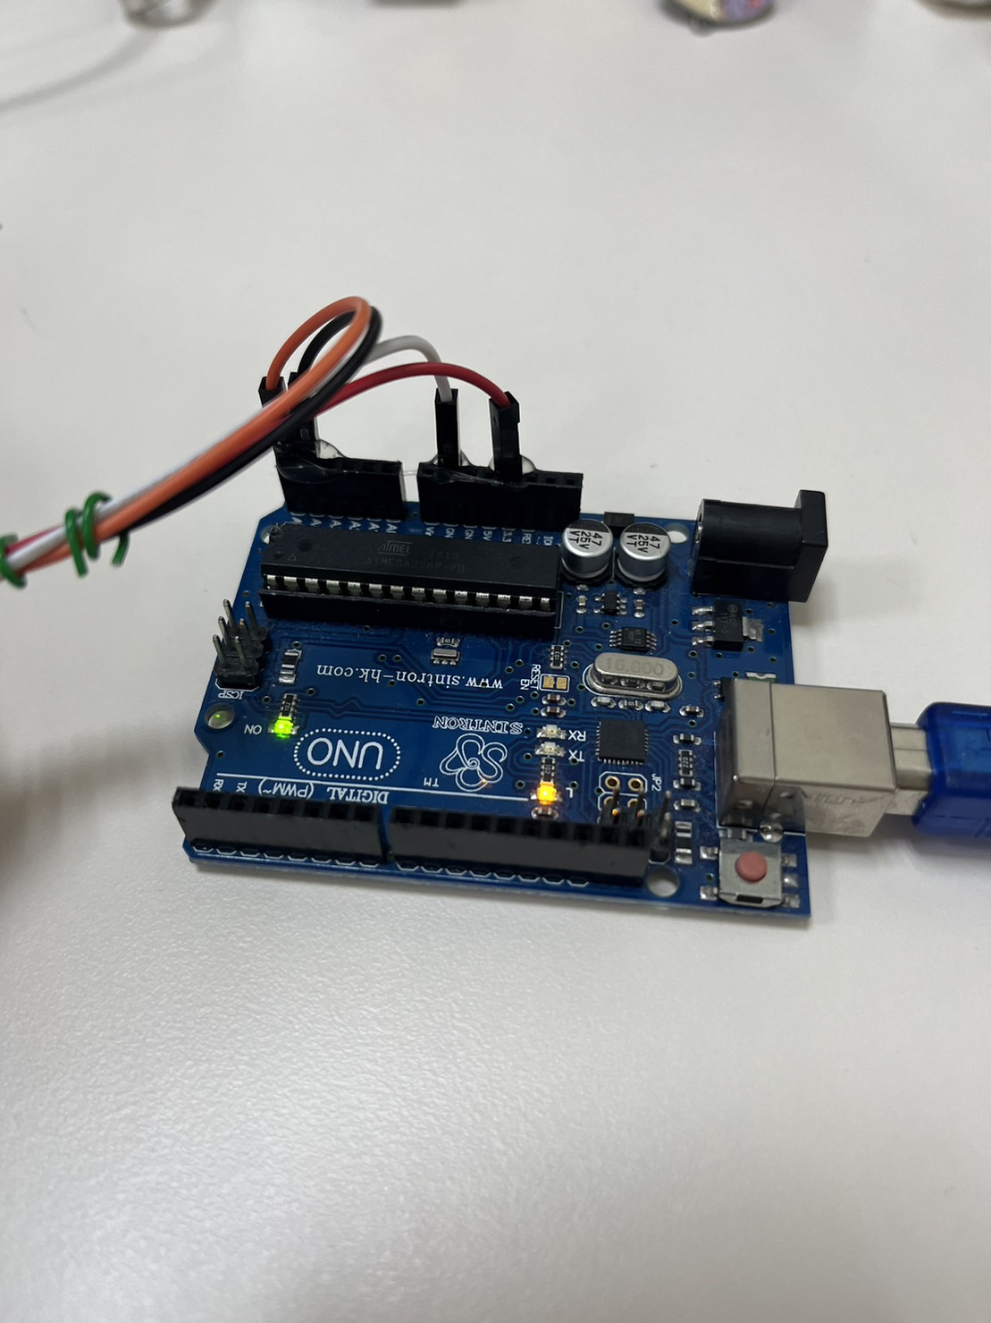
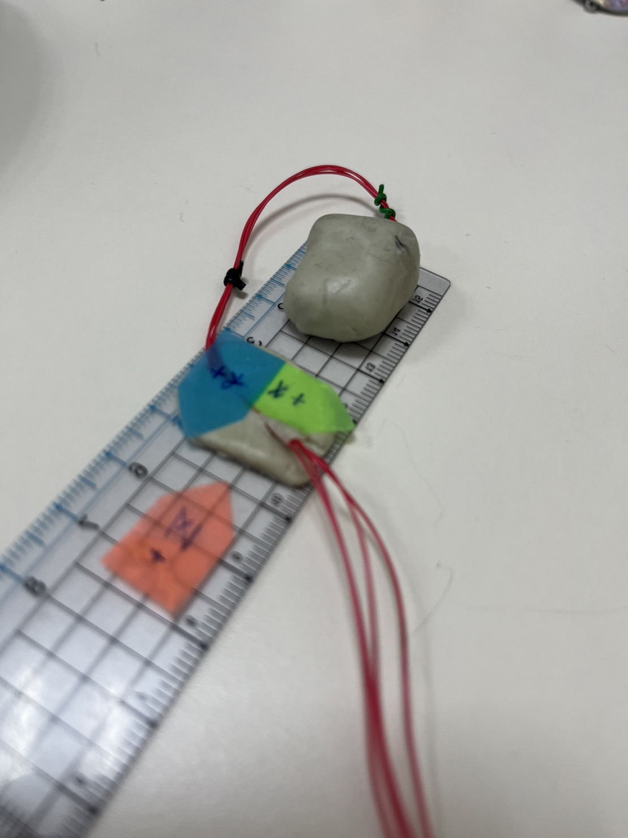
硬體設備
Arduino UNO
MPU9250
九軸感測器

Slide 6
MPU9250感測器設定

Slide 7
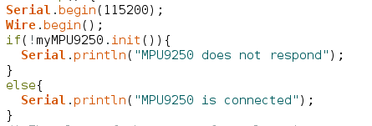
硬體設定-Baud Rate
Baud Rate : 每秒傳輸的符號數量(bps)
原設定為115200，調整為250000 => 時間間隔無變化 仍為每大約0.006秒輸出一筆數據

Slide 8
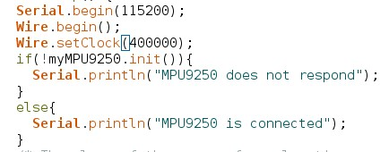
硬體設定-提升採樣頻率
現在採樣頻率約 202Hz

Slide 9
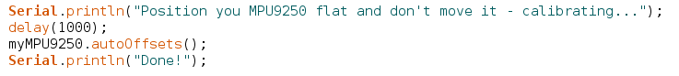
硬體設定-校準
autoOffsets() : 自動校準動作感測器
原設定為autoOffsets() 自動校正，
可調整為setAccOffsets()手動設定參數 =>自動校準較方便且有效率

Slide 10
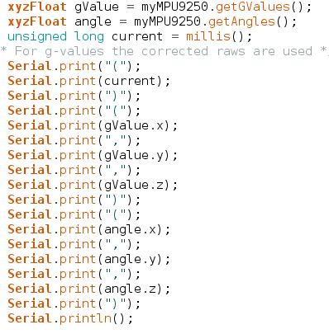
硬體設定-數據輸出
millis() : 毫秒數
(時間)(x軸加速度, y軸加速度, z軸加速度) (Pitch,Roll,Yaw)
Pitch : 相對於水平面前後傾斜角度
Roll : 相對於水平面左右傾斜角度
Yaw : 相對北方的旋轉角度

Slide 11
數據接受與處理

Slide 12
數據處理
Offline
Online
匯出加速度csv數據 再推算速度、距離、位置
(目前暫置)
檢測同時匯出加速度csv數據 且即時推算速度、距離、位置

Slide 13
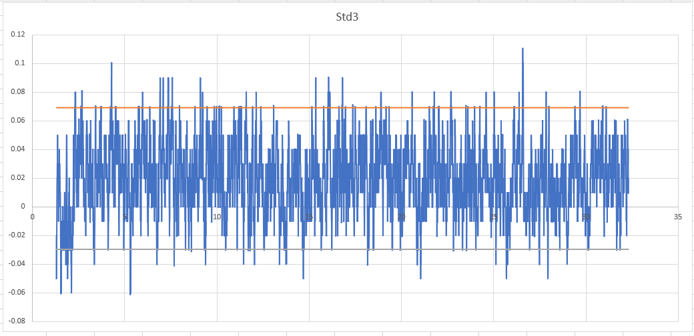

數據處理-標準差Offline
Std*2
匯出加速度csv數據後 利用Excel計算整體數據標準差
再調整倍數以確認篩選範圍
Std*3

Slide 14
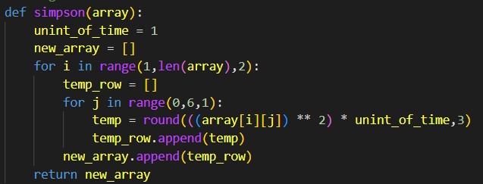
位置推算-Simpson-Offline
利用Simpson積分定理推算距離=> 計算誤差大

Slide 15
Online-數據處理流程
檢測回傳資料格式
感測器建立連線
套用標準差
套用濾波
感測器校正及初始化
計算空間中相對位置
更新資料
繪製關係圖並輸出.CSV

Slide 16
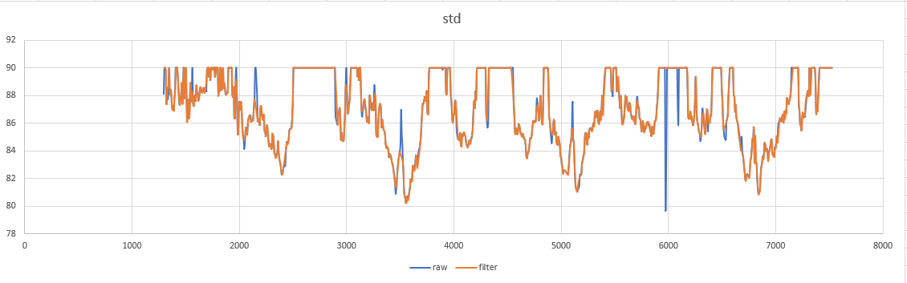
數據處理-標準差Online
每20筆數據切割一次
以切計算一次標準差
觀察篩選效果

Slide 17
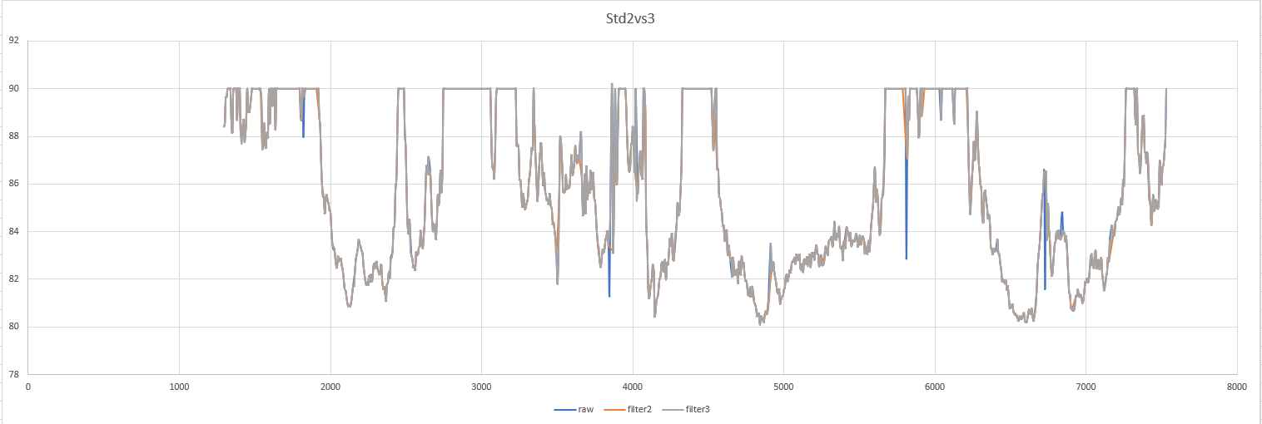
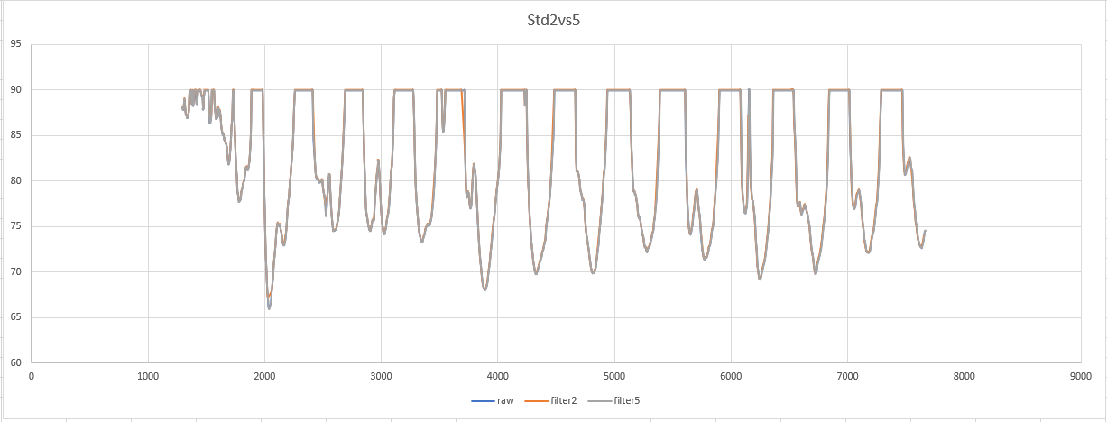
數據處理-標準差Online
調整倍數以確認篩選範圍
計算整體數據標準差?
與濾波的功能效益?
Std*2vs3
Std*2vs5

Slide 18
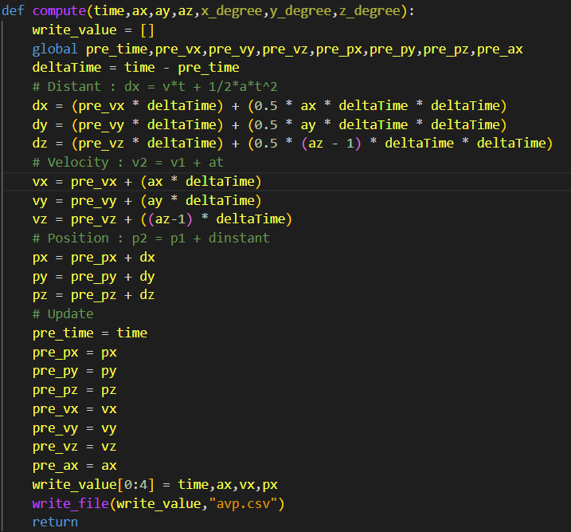
位置推算-Online
藉由物理公式推算位置與距離

Slide 19
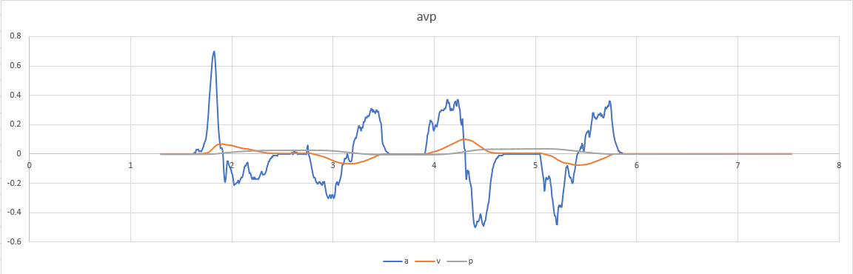
套用標準差之位置推算-Online
加速度、速度、位置

Slide 20
卡爾曼濾波
參考前一刻加速度資訊
推算下一刻加速度值
校正檢測到的下一筆數據

Slide 21
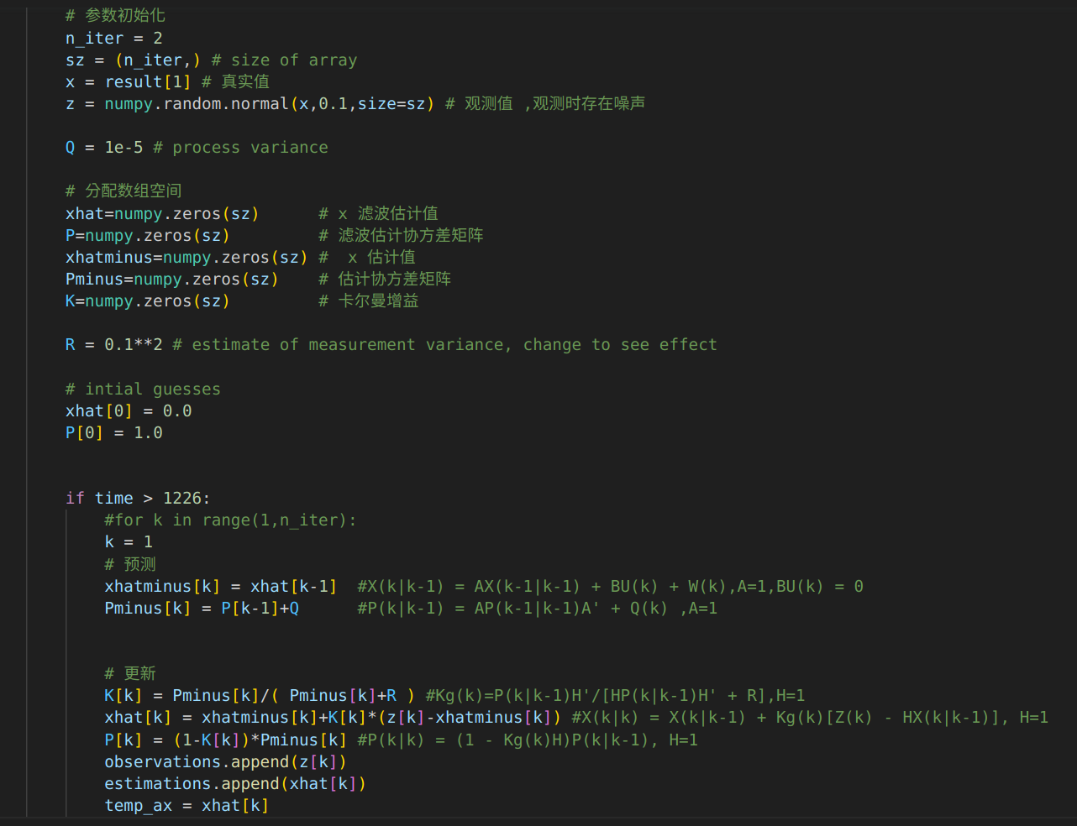
卡爾曼濾波

Slide 22
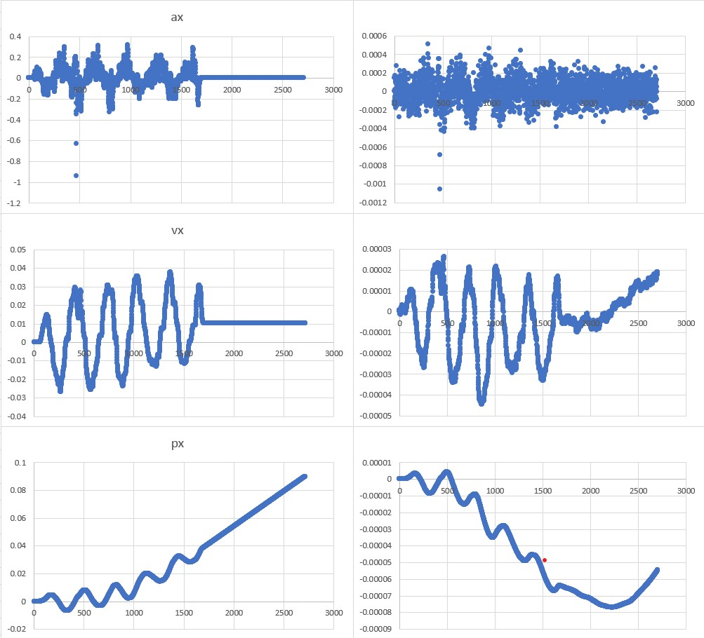
位置推算-Online(套用卡爾曼濾波)
原始
套用濾波
加速度
速度
位置

Slide 23
CONTENTS OF THIS TEMPLATE
You can delete this slide when you’re done editing the presentation
FONTS | To view this template correctly in PowerPoint, download and install the fonts we used
USED AND ALTERNATIVE RESOURCES | An assortment of graphic resources that are suitable for use in this presentation
THANKS SLIDE | You must keep it so that proper credits for our design are given
COLORS | All the colors used in this presentation
ICONS AND INFOGRAPHIC RESOURCES | These can be used in the template, and their size and color can be edited
EDITABLE PRESENTATION THEME | You can edit the master slides easily. For more info, click here
For more info: SLIDESGO | SLIDESGO SCHOOL | FAQS
You can visit our sister projects: FREEPIK | FLATICON | STORYSET | WEPIK | VIDEVO

Slide 24
01
INTRODUCTION
You can enter a subtitle here if you need it

Slide 25
INTRODUCTION
You can give a brief description of the topic you want to talk about here. If you want to talk about Mercury, you can say that it’s the smallest planet in the Solar System

Slide 26
ABOUT THE DISEASE
MERCURY
VENUS
MARS
It’s the closest planet to the Sun and the smallest in the Solar System
Venus has a beautiful name and is the second planet from the Sun
Despite being red, Mars is actually a cold place. It’s full of iron oxide dust

Slide 27
ABOUT THE DISEASE
ABOUT THE DISEASE
TYPE 1
TYPE 2
TYPE 3
VENUS
MARS
JUPITER
EARTH
SATURN
Venus is really hot
Mars is a cold place
Neptune is far from us
We all live on Earth
Saturn is a gas giant

Slide 28
CONCEPTS AND TYPOLOGY
TYPE A
TYPE A
Despite being red, Mars is actually a cold place
Saturn is a gas giant and has several rings
TYPE A
TYPE A
Venus is the second planet from the Sun
Jupiter is the biggest planet of them all

Slide 29
— Someone Famous
“This is a quote, words full of wisdom that someone important said and can make the reader get inspired.”

Slide 30
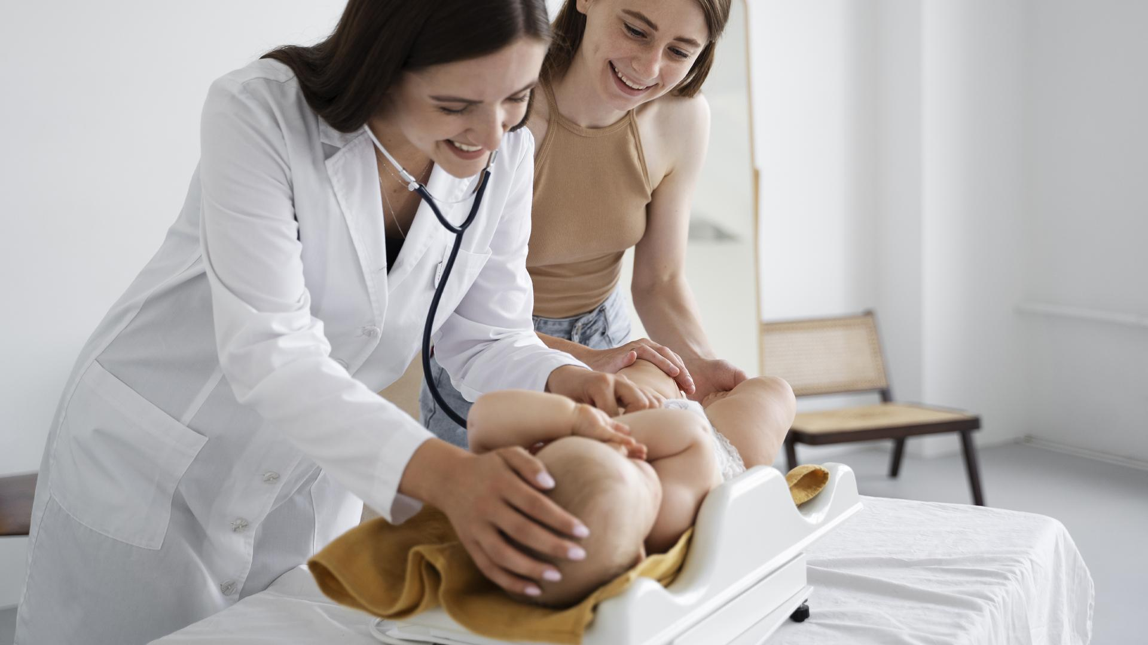
A PICTURE IS WORTH A THOUSAND WORDS

Slide 31
PATHOLOGY
VENUS
MERCURY
Venus has a beautiful name and is the second planet from the Sun
Mercury is the closest planet to the Sun and the smallest one

Slide 32
AWESOME WORDS

Slide 33
SYMPTOMS OF THE DISEASE
01
02
03
MERCURY
It’s the closest planet to the Sun and the smallest in the Solar System
VENUS
Venus has a beautiful name and is the second planet from the Sun
MARS
Despite being red, Mars is actually a cold place. It’s full of iron oxide dust

Slide 34
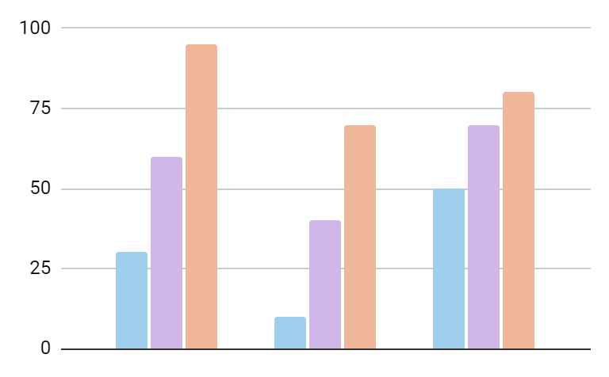
RISK FACTORS
MERCURY
25K
It’s the closest planet to the Sun
VENUS
19K
Venus is the second planet from the Sun
2XXX
2XXX
2XXX
MARS
16K
Follow the link in the graph to modify its data and then paste the new one here. For more info, click here
Mars is actually a very cold place

Slide 35
KEY NUMBERS
50,000
28,000
25,000
Venus is the second planet from the Sun
Saturn is composed of hydrogen and helium
Neptune is the farthest planet from the Sun

Slide 36
150,000
Big numbers catch your audience’s attention

Slide 37
DIAGNOSIS
MERCURY
VENUS
MARS
Mercury is the closest planet to the Sun and the smallest of them all
Venus has a beautiful name, but also high temperatures
Despite being red, Mars is actually a cold place. It's full of iron oxide dust
JUPITER
SATURN
NEPTUNE
Jupiter is a gas giant and the biggest planet in the Solar System
Saturn is the second-largest planet in the Solar System
Neptune is the fourth-largest planet in the Solar System

Slide 38
RECOMMENDATIONS
WHAT TO DO
WHAT NOT TO DO
You can describe what the patient should do here
You can describe what the patient should do here
You can describe what the patient should do here
You can describe what the patient should do here
You can describe what the patient should do here
You can describe what the patient should do here
You can describe what the patient should do here
You can describe what the patient should do here
You can describe what the patient should do here
You can describe what the patient should do here
You can describe what the patient should do here
You can describe what the patient should do here

Slide 39
PREVENTION
 |  | EXAM | ANALYSIS | DIAGNOSIS
 | MERCURY | 0.06 | 0.38 | 0.38
 | MARS | 0.11 | 0.53 | 0.38
 | SATURN | 95.2 | 9.4 | 1.16

Slide 40
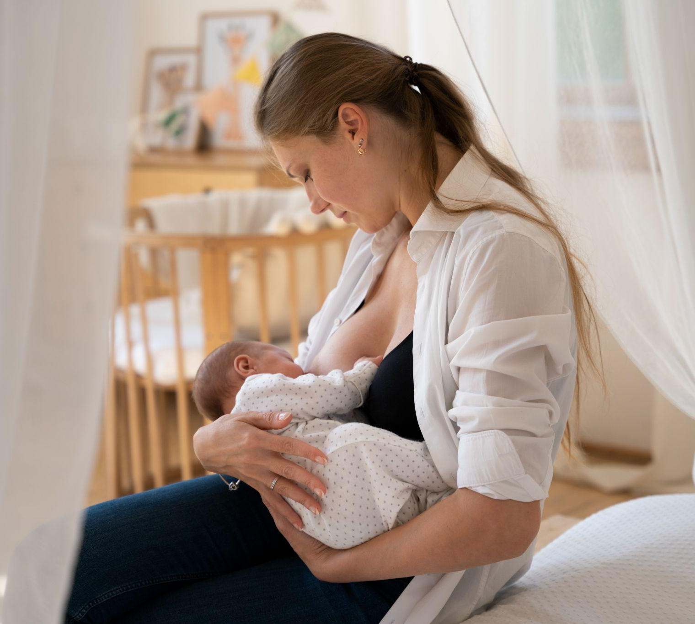
A PICTURE ALWAYS REINFORCES THE CONCEPT
Images reveal large amounts of data, so remember: use an image instead of a long text. Your audience will appreciate it

Slide 41
TREATMENT
01
03
VENUS
MARS
Venus is the second planet from the Sun
Despite being red, Mars is a cold place
02
04
MERCURY
JUPITER
It’s the closest planet to the Sun
It’s the biggest planet in the Solar System

Slide 42
PREVALENCE
MERCURY
It’s the closest planet to the Sun
VENUS
Venus has a beautiful name
MARS
Mars is actually a very cold place

Slide 43
CONCLUSIONS
CONCLUSION 1
CONCLUSION 2
CONCLUSION 3
Mercury is the closest planet to the Sun and the smallest one in the Solar System
Earth is the third planet from the Sun and the only one that harbors life lives
Mars is a cold place. It’s iron oxide dust, which gives the planet its reddish cast

Slide 44


OUR SPECIALISTS
SUSAN BONES
TIMMY JIMMY
You can speak a bit about this person here
You can speak a bit about this person here

Slide 45
TIMELINE
VENUS
JUPITER
Venus is the second planet from the Sun
Jupiter is the biggest planet
1
2
3
4
NEPTUNE
MARS
Neptune is far away from Earth
Despite being red, is a cold place

Slide 46
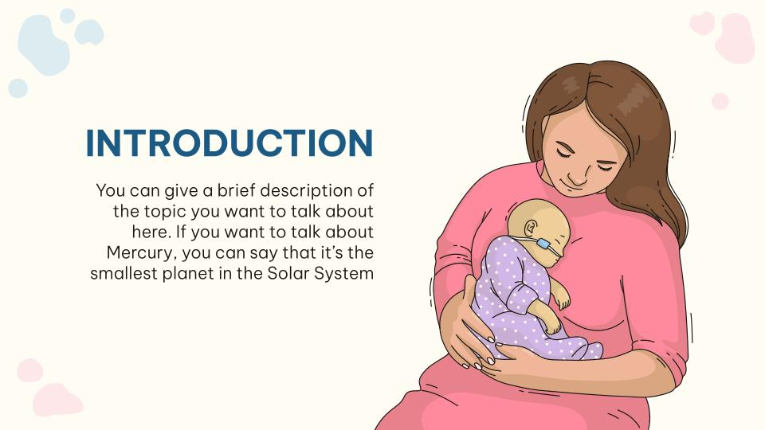
DESKTOP SOFTWARE
You can replace the image on the screen with your own work. Just right-click on it and select “Replace image”

Slide 47
REFERENCES
AUTHOR (YEAR). Title of the publication. Publisher
AUTHOR (YEAR). Title of the publication. Publisher
AUTHOR (YEAR). Title of the publication. Publisher
AUTHOR (YEAR). Title of the publication. Publisher
AUTHOR (YEAR). Title of the publication. Publisher
AUTHOR (YEAR). Title of the publication. Publisher
AUTHOR (YEAR). Title of the publication. Publisher
AUTHOR (YEAR). Title of the publication. Publisher
AUTHOR (YEAR). Title of the publication. Publisher
AUTHOR (YEAR). Title of the publication. Publisher
AUTHOR (YEAR). Title of the publication. Publisher
AUTHOR (YEAR). Title of the publication. Publisher
AUTHOR (YEAR). Title of the publication. Publisher
AUTHOR (YEAR). Title of the publication. Publisher

Slide 48
THANKS!
Do you have any questions?
youremail@freepik.com
+91 620 421 838
yourwebsite.com
Please keep this slide for attribution

Slide 49
ALTERNATIVE RESOURCES
Here’s an assortment of alternative resources within the same style of this template
VECTORS
Hand drawn world prematurity day illustration I
Hand drawn world prematurity day illustration II

Slide 50
RESOURCES
Did you like the resources on this template? Get them for free at our other websites:
VECTORS
Hand drawn world prematurity day illustration I
Hand drawn world prematurity day illustration II
Hand drawn world prematurity day illustration III
Hand drawn world prematurity day illustration VI
Hand drawn world prematurity day illustration V
PHOTOS
Postnatal period with mother breastfeeding child
Adult taking care of baby weight
Cheerful ethnic medic with papers
Medium shot doctor with stethoscope

